Slide 1
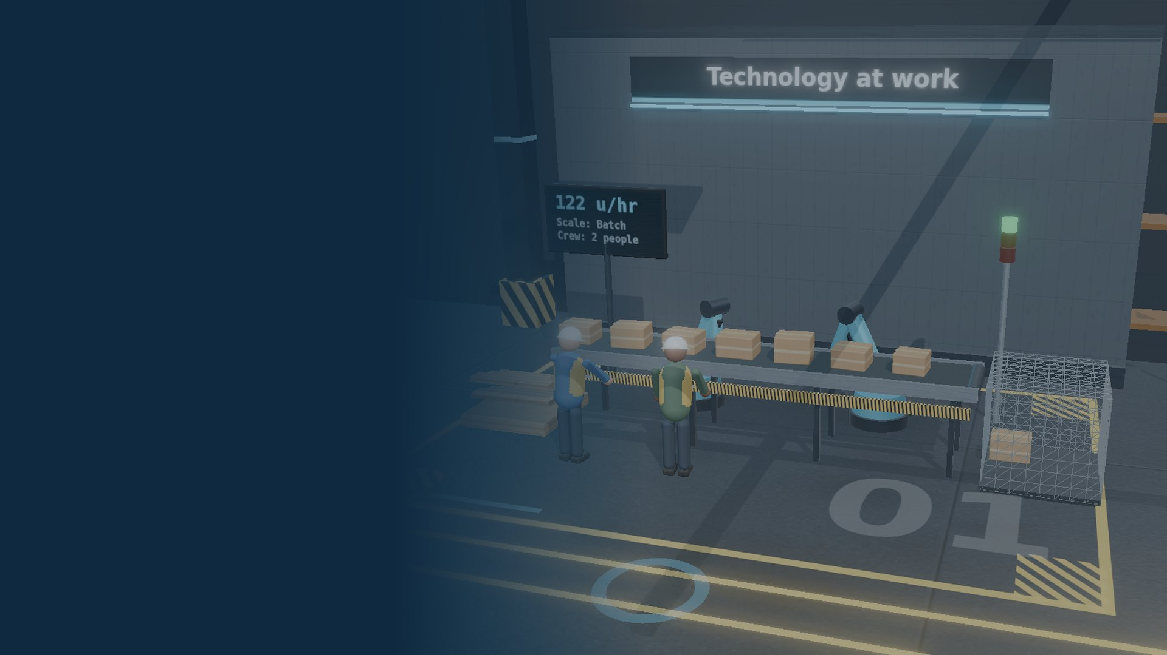
Technology at work
DT CLASSROOM
How new technology changes the tools we use, the places we work and the way new businesses start
Live 3D models for this lesson: www.dtclassroom.com
AQA GCSE Design and Technology 8552 · Lesson 1 of 6
Notes:
Welcome. This is the first lesson on new and emerging technologies. Today covers how technology changes tools and equipment, the design and organisation of the workplace, automation and robotics, and how innovation drives enterprise (crowdfunding, virtual marketing and retail, co-operatives and Fairtrade). Students can open the live 3D production line at www.dtclassroom.com (Units page, first lesson) during the Explore task.

Slide 2
Retrieve: as you come in
DO NOW · 5 MIN
1
A robot arm welding car bodies is an example of…
2
“The Internet and the World Wide Web are the same thing.”
A automation B one-off production C hand finishing
True or false? Be ready to explain.
MULTIPLE CHOICE
TRUE OR FALSE
3
Name one product you have seen with a Fairtrade label.
4
Give one advantage and one disadvantage of using machines instead of people in a factory.
Where did you see it?
SHORT ANSWER
DEPTH
Notes:
Answers: 1) A, automation: a machine performs the task with little human input. 2) False: the Internet is the physical network that carries data (email, streaming, video calls); the World Wide Web is the collection of web pages accessed over it. 3) Any of: bananas, tea, coffee, chocolate, sugar, flowers, cotton clothing. 4) Advantages: faster, more accurate and consistent, works 24/7, can do dangerous jobs. Disadvantages: expensive to buy and maintain, can only do what it is programmed to do, some jobs are lost. Use Q4 to lead into today's lesson.

Slide 3



What we are learning today
Tools, equipment and the workplace
Key words
Explain how new technology has changed tools, equipment, and the design and organisation of the workplace.
Automation
Robotics
Human error
Innovation
Enterprise
Crowdfunding
Virtual marketing
Co-operative
Fairtrade
Obsolete
Automation and robotics
Describe how computers and robots have changed manufacturing, and what they cannot do.
Innovation and enterprise
Explain how crowdfunding, virtual marketing and retail, co-operatives and Fairtrade help businesses start and grow.
Notes:
Share the three objectives. Key word definitions for reference: Automation: using technology to perform tasks with minimal human input. Robotics: machines programmed to carry out physical tasks. Human error: mistakes made by people. Innovation: turning a new idea into a successful product or process. Enterprise: starting and running a business, taking risks for profit. Crowdfunding: raising money from many people, usually online. Virtual marketing: promoting and selling online and through social media. Co-operative: a business owned and run by its members (workers or customers). Fairtrade: a scheme guaranteeing fair prices and conditions for producers. Obsolete: no longer used or useful.

Slide 4






Tools have always changed how we make things
Prehistory
1781
1913
1940s
1989–91
2014
Stone tools
Watt's rotary steam engine
Moving assembly line
Digital revolution
World Wide Web
3D printer in space
Cutting and shaping by hand
Continuous power for factory machines
Ford mass-produces the Model T
Computers process information
Information shared across the world
The ISS prints its own spare parts
Think · pair · share Which of these changed manufacturing the most? What jobs did it make easier, or possible for the first time?
Notes:
Starter discussion. Tools are constantly being developed and refined to meet demand and to use new technology. James Watt did not invent the steam engine, but his 1781 patent gave continuous rotary motion that could drive factory machinery (the watt, the unit of power, is named after him). Henry Ford's moving assembly line (1913) made mass production practical. The digital revolution from the 1940s brought computing power; Tim Berners-Lee proposed the World Wide Web in 1989 and it went public in 1991. In 2014 a 3D printer on the International Space Station printed parts in orbit, so astronauts can make replacement parts instead of waiting for a supply launch. Ask pairs to justify their choice.

Slide 5

The Internet is not the World Wide Web
The Internet
The World Wide Web
The physical network of connected computers and cables that carries data around the world.
The collection of web pages and sites that we access using the Internet.
Email and messaging
Video calls
Sending CAD files to a factory
Online shops
Crowdfunding pages
Supplier catalogues
The “global village” Together they make it easy to find materials, parts, designers and workers anywhere in the world, and to sell to customers anywhere.
Notes:
Return to retrieval question 2. The Internet is the network infrastructure; the Web is one service that runs on it (others include email and video calling). The 'global village' idea: communication technology shrinks distances, so businesses can source goods, parts and labour from much further afield, and small firms can reach global markets.

Slide 6
New tools are faster, safer and more accurate
Digitisation
So work becomes…
Machines controlled by computers: CAD/CAM, CNC, laser cutters
More accurate
Faster
Networking
More productive
More convenient
Machines and stock systems share data automatically
Safer
New materials
Tougher, lighter, more flexible or more conductive parts
Example
Stock control used to mean counting shelves by hand. Barcode scanners now update stock levels the moment an item is sold, and can reorder automatically.
Notes:
New technologies built into modern tools include digitisation, networking and new materials with more desirable properties (flexibility, hardness, toughness, conductivity). These make jobs like stock control and manufacture more accurate, faster, more productive, more convenient and safer. Ask: which of these benefits matters most in a school workshop? (Safety and accuracy are usual answers: laser cutters and CNC routers are guarded and repeat cuts exactly.)

Slide 7
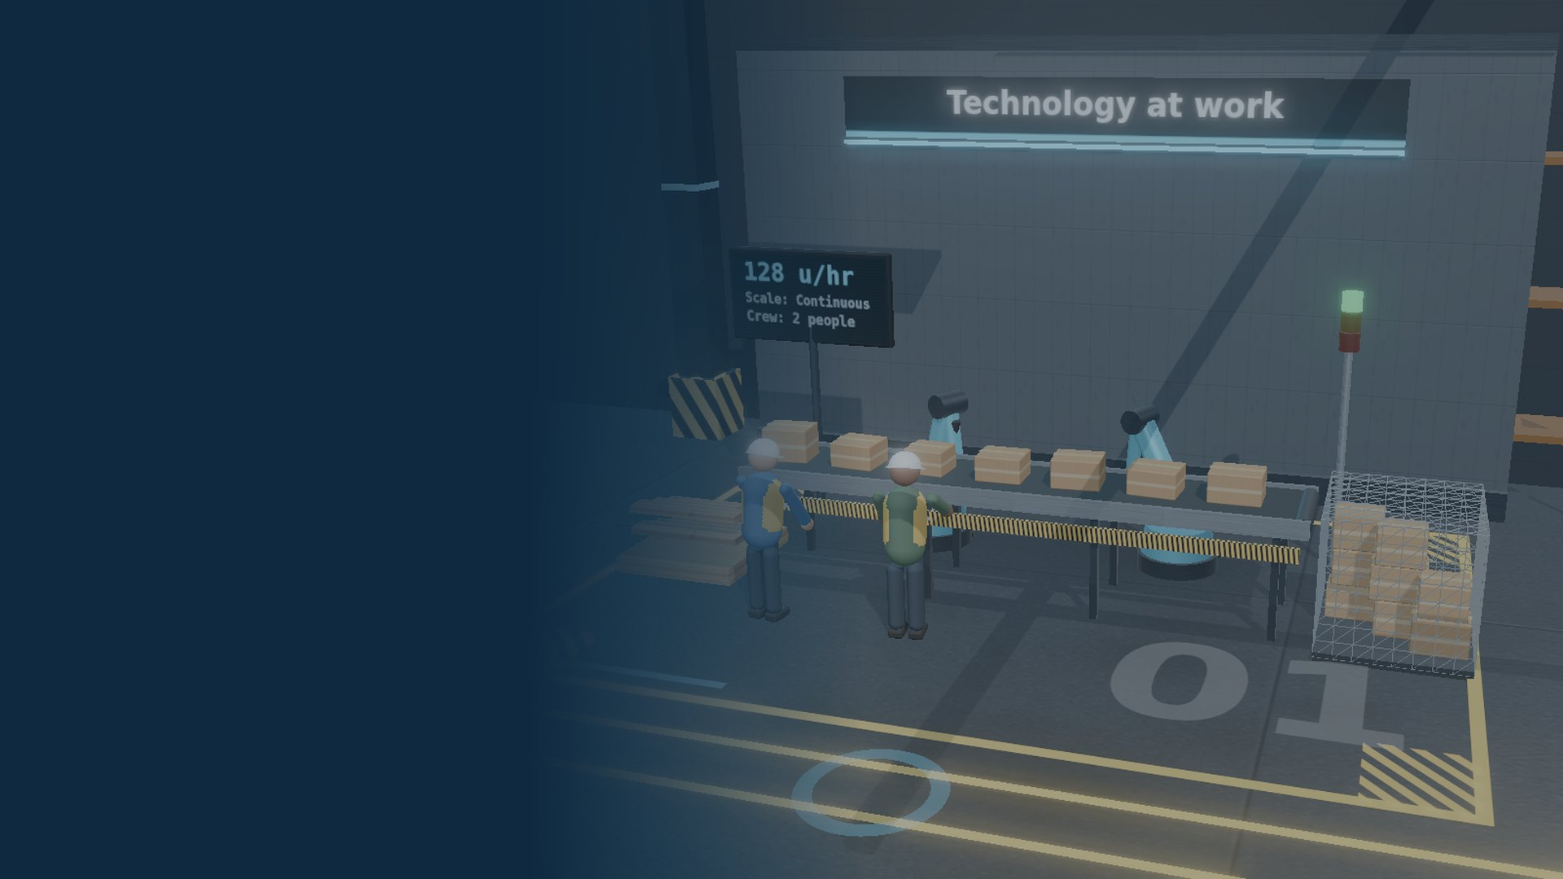
Automation and robotics
PART 2
What machines do well, what they cannot do, and what happens to the jobs
Notes:
Section divider: automation and robotics.

Slide 8
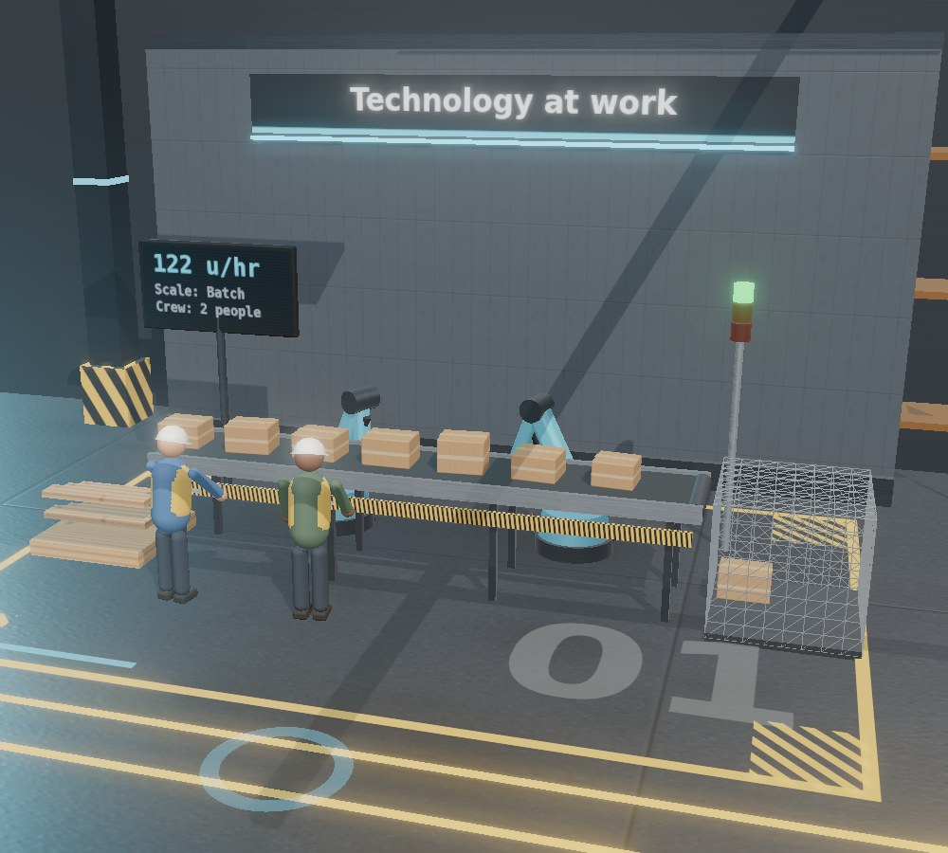
Robots are precise, but only do what they are told
✓
Good at
Repetitive jobs that need accuracy
Dangerous, hot or heavy work
Working 24/7 without tiring
Identical products, no human error
✕
Cannot do
Anything they are not programmed to do
Adapt to a new task on their own
Run without skilled maintenance
Pay for themselves quickly: they cost a lot
A highly automated line in DT Classroom: robots weld, a small crew supervises.
Notes:
Ask students what jobs robots are good at before revealing. Robots are best at repetitive tasks needing accuracy. They cannot do anything they have not been programmed to do. Automation may replace one job but it creates others (programming, maintenance, supervision). Analogy: a Formula One team. The driver (the robot) gets the attention, but the pit crew, technicians, engineers and development team make the result possible. Job changes are covered again in a later lesson on people and society.

Slide 9



Automation is already all around us
Robotic milking
Automated warehouses
Cows walk into the robot when they choose to be milked. Farms using it often report higher milk yields.
Robots bring shelves to the packer, so orders are picked faster with fewer mistakes.
Car body welding
Barcodes and stock control
Robot arms weld and paint car bodies on the production line with the same accuracy every time.
Every sale is scanned, stock levels update and new stock is ordered automatically.
Notes:
Show examples of automation in rural areas as well as in shops and factories. Suggested videos (search on YouTube): a BMW car factory tour showing robot welding and painting; a fully automated warehouse. Robotic milking: cows choose when to be milked, so they are milked more often and more calmly; studies and farm reports show yields can increase. Barcodes: EPOS (electronic point of sale) links every sale to stock control. Ask: who still has a job in each example? (Engineers, programmers, maintenance staff, farmers managing herd data.)

Slide 10
Read a barcode
PAIR TASK · 5 MIN
Your task
Find two products made by the same company (or use the photos your teacher shows).
Compare the first group of digits. What do you notice?
Now compare the second group. Why are they different?
How does this help a shop with stock control?
0
12345
67890
5
System
Manufacturer code
Product code
Check digit
UPC-A barcode (example digits)
Notes:
On a standard UPC-A barcode the left set of numbers is the manufacturer code and the right set is the product code. Different products from the same manufacturer share the left-hand digits. The final digit is a check digit used to catch scanning errors. Stock control link: scanning identifies exactly which product sold, so stock levels update automatically and reorders can be triggered. (European EAN-13 barcodes work in a similar way with a country prefix.)

Slide 11
Show me
MINI-WHITEBOARD
Which task is a robot best suited to?
✓ Answer: B
A
Designing a new chair for a client
B
Spray painting 500 identical car doors
C
Negotiating prices with a supplier
D
Comforting a patient in hospital
Write the letter, then one reason why.
Notes:
Answer: B. It is repetitive, needs consistent accuracy, involves hazardous fumes, and the task is the same every time, so it can be programmed. A, C and D need creativity, judgement, negotiation or empathy, which robots cannot do because they only do what they are programmed to do.

Slide 12
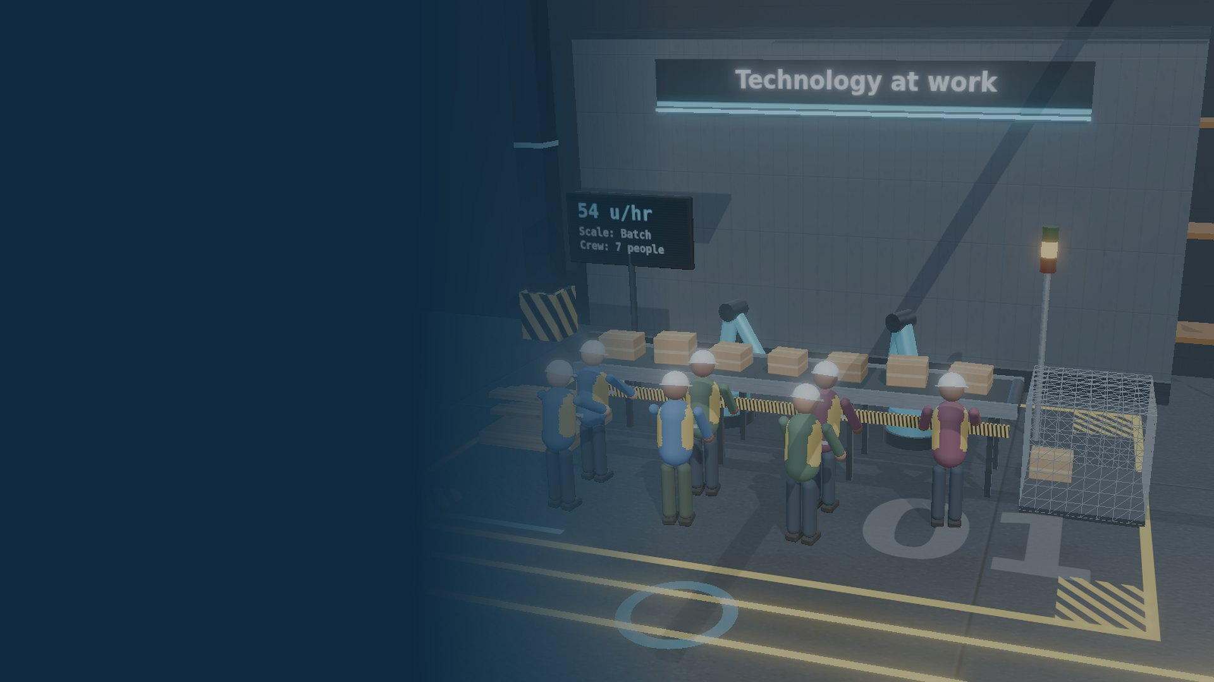
The workplace
PART 3
How technology changes who does what, where they do it and how a building is laid out
Notes:
Section divider: organisation and design of the workplace.

Slide 13




Technology changes who works, where and when
Flexible job roles
People move between tasks as machines take over routine work.
Working round the clock
Three teams, eight-hour days, eight hours apart: the project never stops.
Remote working
Networks let designers work from home or another country, so less office space is needed.
Freelancers
00:00
08:00
16:00
24:00
Firms hire specialists for a single project instead of employing them full time.
London 08:00–16:00 UK time
San Francisco 16:00–00:00 UK time
New systems
Procedures change when a process goes from manual to automatic.
Singapore 00:00–08:00 UK time
Times shown in UK winter time.
Notes:
Ask how technology has influenced job roles, physical layout and systems. Roles become more flexible; networking allows remote working; firms use freelancers who work remotely, which can reduce office space. 'Follow the sun' working: with three teams placed eight hours apart, each working an eight-hour day, a project can develop 24 hours a day. In UK winter time, a London team works 08:00–16:00, a San Francisco team's 08:00–16:00 is 16:00–00:00 UK time, and a Singapore team's 08:00–16:00 is 00:00–08:00 UK time.

Slide 14
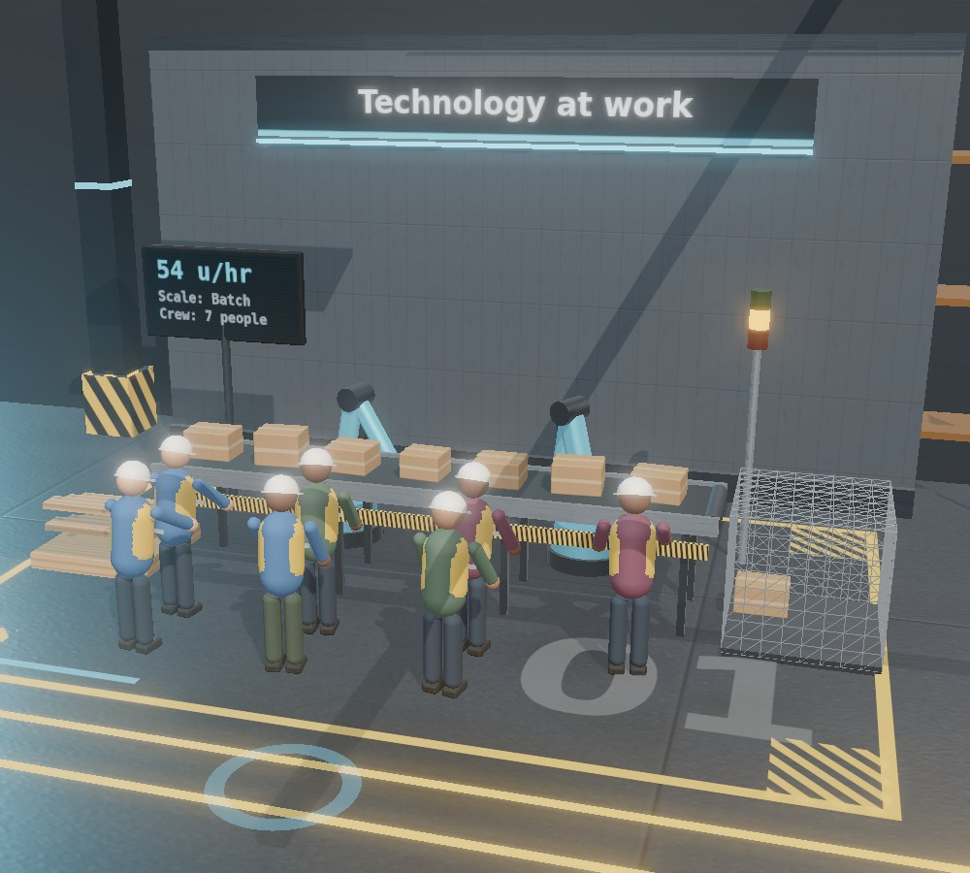

Good layout keeps people and products flowing
A factory laid out in the order things are made
Goods in
Make parts
Assemble
Check
Dispatch
Less walking and waiting means more products per hour (throughput) and fewer accidents.
Think about a supermarket
Why is fresh fruit and veg almost always by the entrance, while milk and bread are at the back?
Layout decides how far people and parts have to travel.
Notes:
The physical layout and flow of a factory floor, office or shop affects productivity and output. Supermarket answers: fresh produce by the door sells perishables quickly while trolleys are empty and the display looks attractive; staples like milk and bread at the back make customers walk past other products. Factories that get their production flow right improve throughput. New machinery can mean the layout has to change to keep the flow working.

Slide 15
Workplace makeover
GROUP TASK · 10 MIN
Copy and complete the table. One row is done for you.
Workplace | New technology | How the work changed | One benefit | One drawback
Supermarket | Self-checkouts and barcode scanners | Staff move from tills to helping customers and restocking | Shorter queues; live stock levels | Fewer till jobs; some customers find it harder
Car factory
Design studio
Your choice
Notes:
Groups of three or four. Suggested answers. Car factory: robots for welding and painting; workers become supervisors, programmers and maintenance technicians; consistent quality, safer, works 24/7; high cost, fewer assembly jobs, retraining needed. Design studio: CAD, rendering, video calls and cloud storage; designers work remotely and share files instantly, clients see realistic models before anything is made; faster changes, fewer physical prototypes; expensive software, reliance on networks, new skills needed. Take feedback from one group per row.

Slide 16
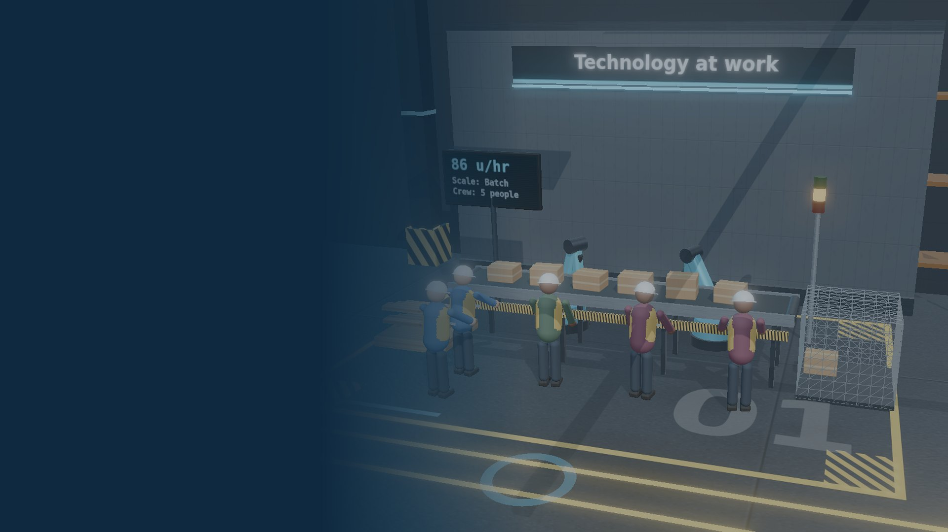
Innovation and enterprise
PART 4
New technology creates new products, and new ways to fund and sell them
Notes:
Section divider: innovation and enterprise.

Slide 17




New technology sparks new products and businesses
3D printing
Nanotechnology
Graphene
Prototypes and one-off parts made straight from CAD. Bioprinting is testing printed living tissue.
Engineering materials at a tiny scale, such as self-cleaning or anti-bacterial coatings.
A single layer of carbon atoms: very strong, light and highly conductive.
Small businesses can now compete with big ones
An online shop and social media reach customers worldwide, 3D printing removes the need for expensive tooling, and freelancers can be hired from anywhere.
Notes:
Developments in new technology drive innovation. Exciting emerging technologies include 3D printing (including 3D bioprinting), nanotechnology and graphene. They are still developing and are fuelling a new wave of ideas and enterprise. Discuss how small businesses benefit: low start-up costs for online selling, rapid prototyping without expensive moulds, and access to a huge pool of internet-connected freelancers and suppliers.

Slide 18


The internet lets anyone fund and sell an idea
Crowdfunding
Virtual marketing and retail
Augmented reality
Many people each pay a small amount, usually online, to fund a product before it exists. Backers often get the product first.
Promoting and selling online: social media, targeted adverts, influencers and online shops open 24/7.
Digital images laid over the real world through a phone or headset.
It also tests demand: if nobody backs it, few would buy it.
Cheap to start, and it reaches a worldwide audience.
Customers place furniture in their room before buying; workers follow 3D instructions in training.
Notes:
Explain each with examples. Crowdfunding: platforms such as Kickstarter or Indiegogo; pledges usually only collected if the target is reached; risk for backers is that the product may be late or never delivered. Virtual marketing and retail: social media campaigns, targeted adverts using data, influencers, online stores. Augmented reality: used by industry to improve training, workflow and accuracy, for example showing assembly steps over a real engine, and by retailers to show products in the customer's room. Suggested video: search 'augmented reality in manufacturing training'.

Slide 19

Co-operatives and Fairtrade share the rewards fairly
Co-operatives
Fairtrade
A business owned and run by its members: its workers or its customers.
A scheme that guarantees producers a fair minimum price and decent working conditions.
Members share the profits and have a say in decisions
People work in the best interests of the business, so productivity and commitment rise
Those closest to the work suggest improvements, which drives innovation
Found on tea, coffee, bananas, chocolate, flowers and cotton
An extra premium pays for community projects such as schools and wells
Customers can choose products that treat workers fairly
Notes:
Co-operative organisations are usually owned and run by their own employees or customers. Shared ownership gives people a stake, so they naturally work in the best interests of the organisation, boosting productivity and commitment, and those most involved are often best placed to suggest improvements. Describe the Fairtrade Foundation and ask where students have seen the label (link back to retrieval question 3): typically consumables such as flowers, tea, fruit and vegetables, and harvested materials such as cotton.

Slide 20




Is new technology always a good thing?
DEBATE · 5 MIN
Obsolescence
“New technology only ever makes things better.”
Products, machines and skills become obsolete as newer technology replaces them.
Jobs and retraining
Some workers lose jobs to automation and find it hard to retrain.
Privacy
Biometrics (fingerprints, face scans) and online tracking collect personal data.
Agree or disagree? Use one example from today.
Cost and waste
New equipment is expensive, and replaced devices become electronic waste.
Notes:
Common misconception: new technology only brings positive outcomes. Students should recognise trade-offs: products and skills can become obsolete; workers displaced by automation may struggle to retrain; biometric systems and online marketing raise privacy questions; new equipment is costly and old devices add to electronic waste. A good answer weighs both sides and reaches a judgement. (Misconception and the keywords obsolete, human error and biometrics draw on Oak National Academy's 'New and emerging technologies' lesson, OGL v3.0.)

Slide 21
Explore it in DT Classroom
3D LAB · 10 MIN
Your task
Set automation to 15%. Record the output per hour and the crew size.
Repeat at 50% and 90%.
Change the production quantity. When does the scale switch from batch to mass?
Write two sentences: what is gained and what is lost as automation rises?
15% automation: big crew
90% automation: robots lead
www.dtclassroom.com
Units page → first lesson → production line
Notes:
Students use the live 3D production line (Units page, first lesson) on laptops, tablets or the projector. The automation slider changes robot speed, crew size and the andon light; the quantity slider changes the scale label (one-off, batch, mass, continuous). Expected pattern: output rises and crew falls as automation rises. The numbers are a simplified teaching model, not real factory data. Follow up with the next slide.

Slide 22
More automation: more output, fewer people
×2.3
output per hour, from 15% to 90% automation
7 → 2
people needed on the line
Production quantity 400. DT Classroom teaching model, not real factory data.
Notes:
Values from the DT Classroom production-line model at a quantity of 400: 15% automation gives about 54 units per hour with a crew of 7; 50% gives 86 with 5; 90% gives 122 with 2. Discuss: output more than doubles while the crew falls from 7 to 2. What new jobs appear (programming, maintenance, quality control)? What does the business have to pay for first (robots, training)? Remind students the model is simplified.

Slide 23
Exam practice
EXAM PRACTICE
Explain two ways in which automation has changed manufacturing.
[4 marks]
How the marks work
1 mark for each way you identify
1 more mark for each explanation of its effect
Use a real example: robots, CNC, warehouses
“Explain” means say why or how, not just name it
Writing frame
One way automation has changed manufacturing is… This means that…
A second way is… As a result…
Notes:
Indicative content (1 mark for each valid point, 1 for its development, up to 4): Robots carry out repetitive tasks such as welding and painting (1), so products are more consistent with less human error (1). Production can run 24 hours a day (1), increasing output and lowering the cost per product (1). Fewer manual assembly jobs are needed (1), but new skilled jobs are created in programming and maintenance (1). Dangerous tasks are automated (1), making the workplace safer (1). Computer-controlled stock systems order parts automatically (1), reducing waste and storage space (1). This is a teacher-written practice question in the AQA style, not taken from an AQA paper.

Slide 24
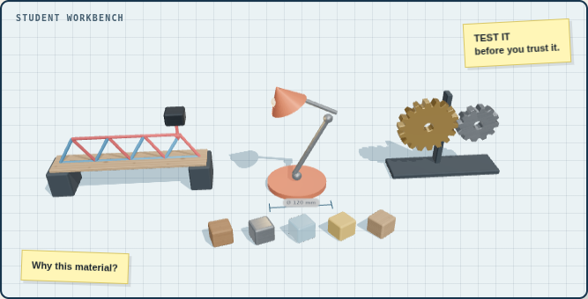
Stretch: the automated canteen
STRETCH
Your school wants to automate its canteen completely.
Which jobs could machines take over, and which could they not?
What new jobs would the school need?
How might the layout of the canteen change to improve flow?
Would you recommend it? Give a judgement and justify it.
Think about repetitive tasks, hygiene and safety, cost, allergies and special diets, and the people who would lose or gain jobs.
Notes:
Extension for students who finish early. Strong answers apply the whole lesson: robots suit repetitive, hygienic tasks (dispensing, washing up, payment by card or biometrics); they cannot judge allergies or care for students who need help; new jobs include maintenance and programming; layout changes for flow; the judgement weighs cost, jobs, speed, waste and privacy.

Slide 25

Exit ticket
INDEPENDENT · 5 MIN
3
ways new technology has changed the workplace
Homework
2
things robots cannot do
Find a real product that was crowdfunded. Explain how crowdfunding and virtual marketing helped it reach customers, and one risk the backers took.
1
way a new business could raise money or sell its product
Next lesson: designing for a sustainable future
Notes:
Students complete the 3-2-1 on paper or mini-whiteboards; collect a sample to check understanding. Model answers: 3 workplace changes: flexible roles, remote working, freelancers, automated systems, new layouts. 2 things robots cannot do: act beyond their programming, show creativity or empathy, maintain themselves. 1 way to raise money or sell: crowdfunding, virtual marketing, online retail, augmented reality. Set the homework, or use your own homework sheet if your department has one.

Slide 26

Sources and credits
Written for DT Classroom and aligned to the AQA GCSE Design and Technology (8552) specification, section 3.1.1: New and emerging technologies.
The misconception and the keywords obsolete, human error and biometrics draw on “New and emerging technologies”, a Design and Technology lesson by Oak National Academy, licensed under the Open Government Licence v3.0.
All images are renders from DT Classroom's own 3D scenes. Icons: Font Awesome and Game Icons via react-icons.
Practice exam questions are teacher-written in the AQA style and are not taken from AQA papers.
Live models for every lesson at www.dtclassroom.com
Notes:
Attribution slide. Keep it in the deck when sharing.

